Slide 1
Scenario
You're a junior security analyst, an entry-level professional responsible for monitoring networks and investigating security incidents. Your system has flagged some unusual activity. Your task is to review the following simplified log data to identify potential threats or policy violations.
You'll be using NotebookLM, an AI-powered tool, to help you with this investigation. It can assist you in sifting through data to find key patterns and anomalies, just like a modern analyst would.
Goal:
Analyze the log data below, identify any suspicious events, and use your findings to answer the questions.

Slide 2
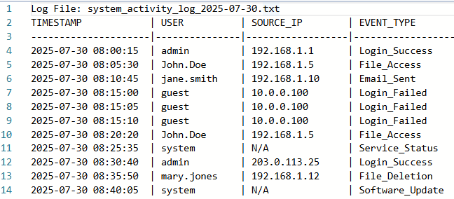
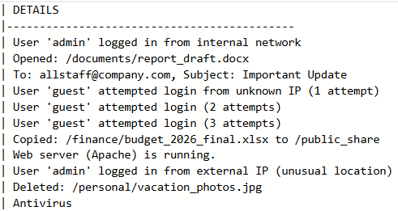
Investigate with the AI: Think like a detective. Ask NotebookLM questions to help you understand the data. Some good starting prompts might be:
"What do these logs tell me about user activity?"
"Can you identify any events that seem out of the ordinary?"
“Based on a security perspective, what are the most concerning log entries and why?"

Slide 3
